Slide 1
Bridging gaps
in the Americas
2023

Slide 2
About
The Trust for the Americas
501(c)(3) not for profit organization
Affiliated with the Organization of American States
Legal presence in Canada & Colombia
Based in Washington DC

Slide 3
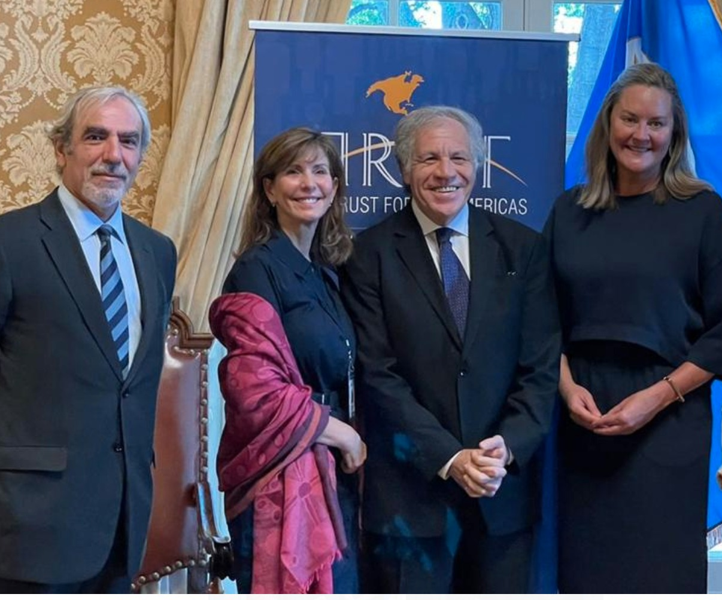
Working with the OAS
Implement projects mandated by the SG and Member States
Connect the private with the public sector.
Vehicle within the OAS.
Notes:
Joint projects and affiliated New Path

Slide 4
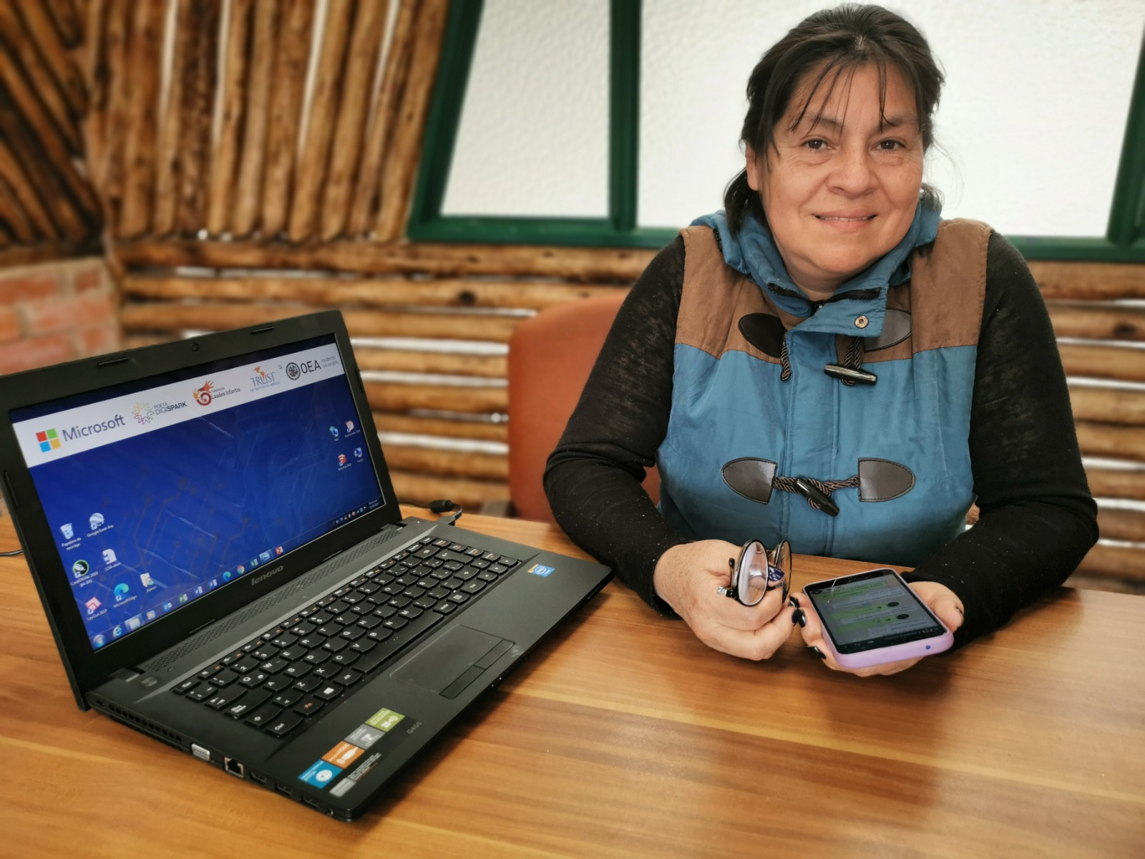
What we do
Promote social and economic inclusion for vulnerable communities in the Americas through partnerships with the public, private and non-profit sectors.
Areas of focus:
Future of work
Innovation

Slide 5
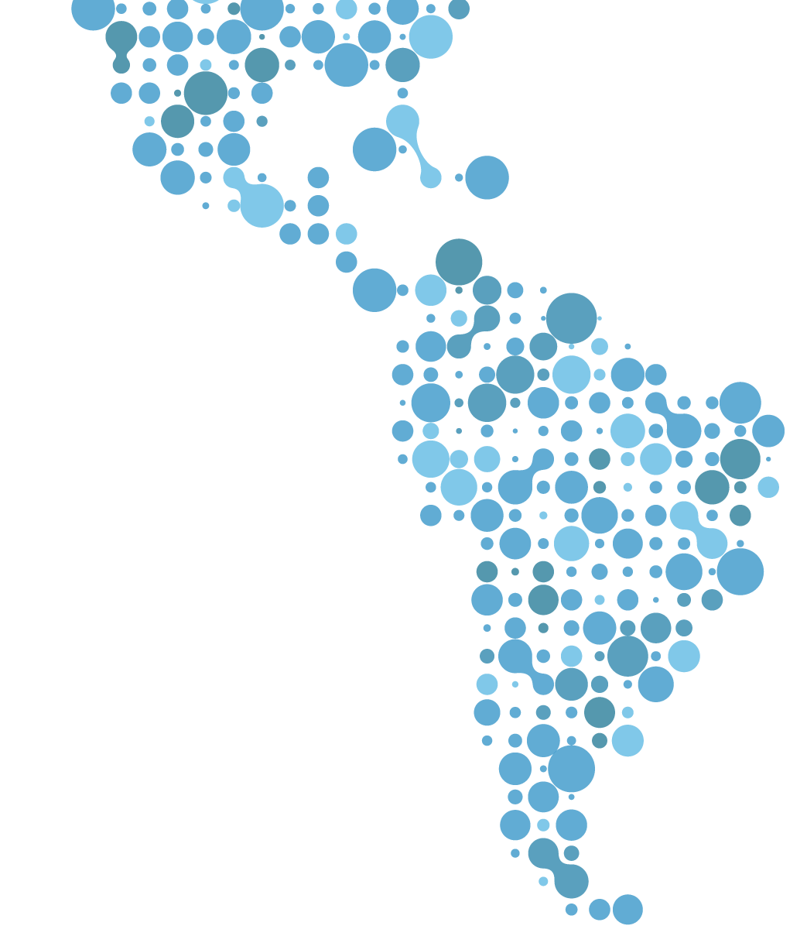
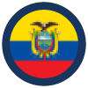
OUR FOOTPRINT
29
ANTIGUA & BARBUDA ARGENTINA
BARBADOS BELICE BRASIL BOLIVIA
CANADA CHILE COLOMBIA COSTA RICA DOMINICA REPÚBLICA DOMINICANA ECUADOR EL SALVADOR GRANADA GUATEMALA HAITÍ HONDURAS JAMAICA MÉXICO PANAMÁ PERÚ PUERTO RICO (USA)
PARAGUAY SANTA LUCIA SAN CRISTÓBAL Y NIEVES TRINIDAD Y TOBAGO URUGUAY VENEZUELA
Countries historically
1,000
Organizations
4.5M
Impacted People
384
POETA Centers
DIA Labs

Slide 6
How we do it:
Technology as a cross cutting tool
Technology for the skills needed for economic independence.
In-Person Technology Training Centers.
Aula Virtual: over 70 courses online

Slide 7
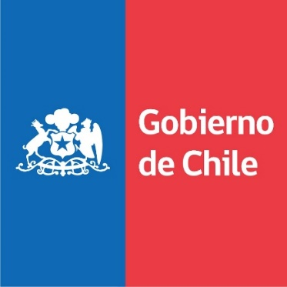
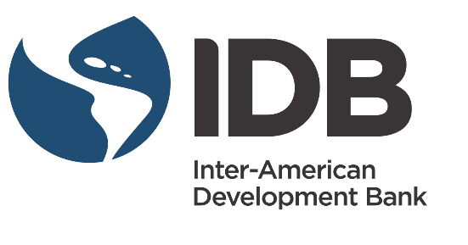
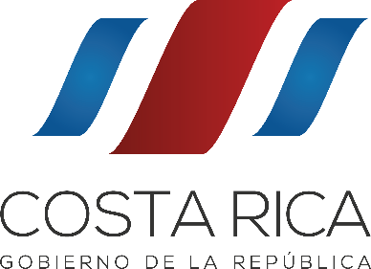
Leveraging our Partnerships
PUBLIC SECTOR
PRIVATE SECTOR
Notes:
Key partnerships – work with OAS missions – 70% funding comes from private sector

Slide 8
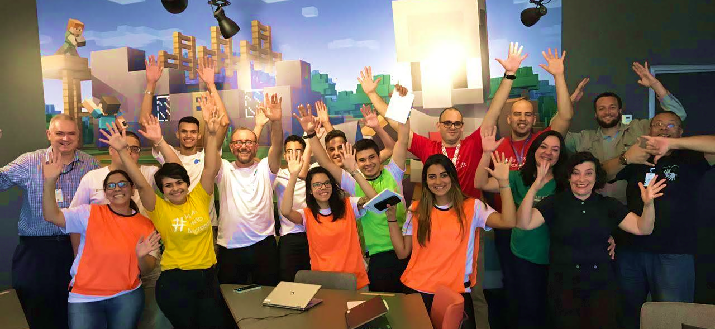
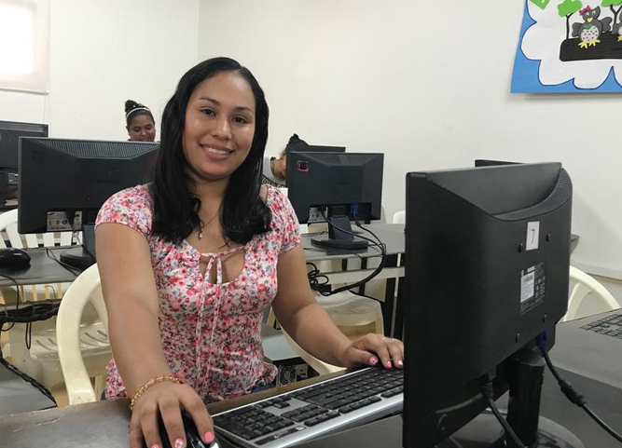
Partnering with local CSOs
Five Core Strategies: Comprehensive training, communications, economic opportunities, M&E, sustainability.
How we do it:
Strengthening Local Partners
Notes:
1,000 over the years – currently parterned with 51 CSOs

Slide 9
Provide skills
Help people get jobs and expand micro-enterprises.
Promote innovation in small businesses & governments.
Programs

Slide 10
Cross Cutting Themes
Gender
Entrepreneurship
Adaptation to risk/climate change

Slide 11
The Trust for the Americas
Follow us on Social Media
The Trust for the Americas
Trust4Americas
Trust4Americas

